Slide 1
Zotikon
Athlete Analysis System

Slide 2
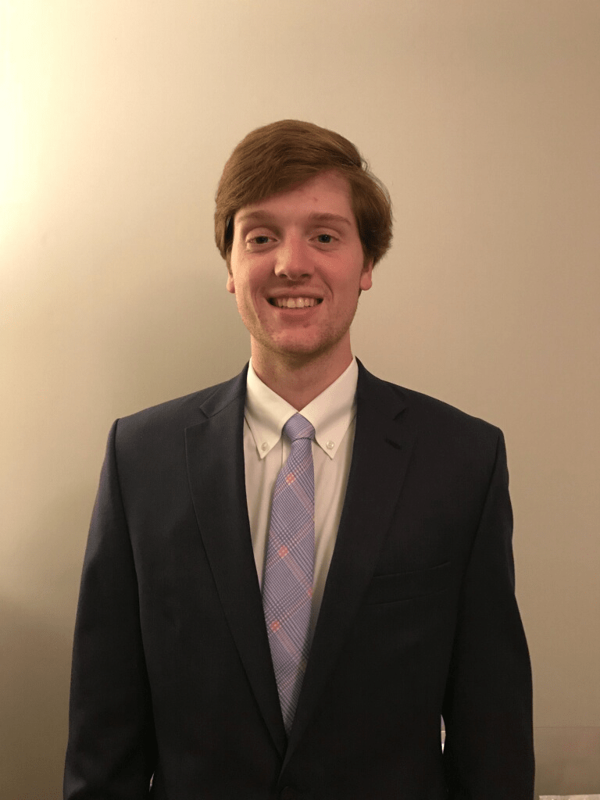
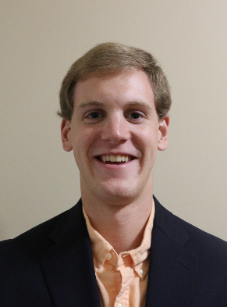
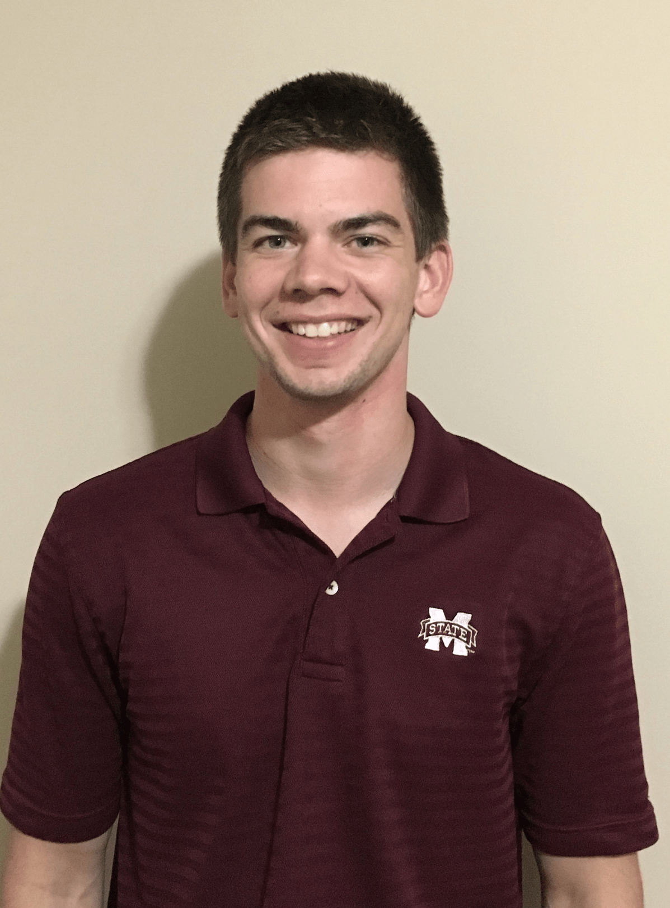

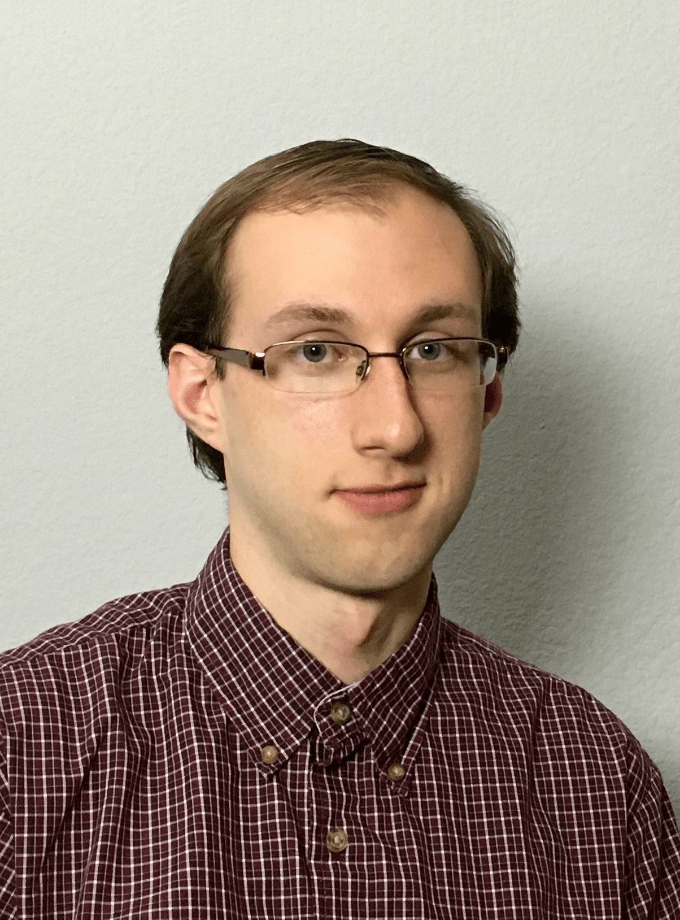
The Zotikon Team
Bruce Bowlin
Eric Farmer
Joseph Hastings
Van Kingma
Curtis Prehn

Slide 3
Zotikon’s Advisor
Dr. Mehmet Kurum
Assistant Professor
PhD, Electrical and Computer Engineering, George Washington University, 2009
Fields of Interest
Microwave and Millimeter-wave Remote Sensing
RF Sensors & Systems
Radiation and Scattering Theory
Antennas & Computational Electromagnetics
Subsurface & Subcanopy Sensing and Imaging
GNSS Reflectometry

Slide 4
Outline
Problem Statement
Design Constraints
Evaluation & Progress
System Overview
Timeline

Slide 5
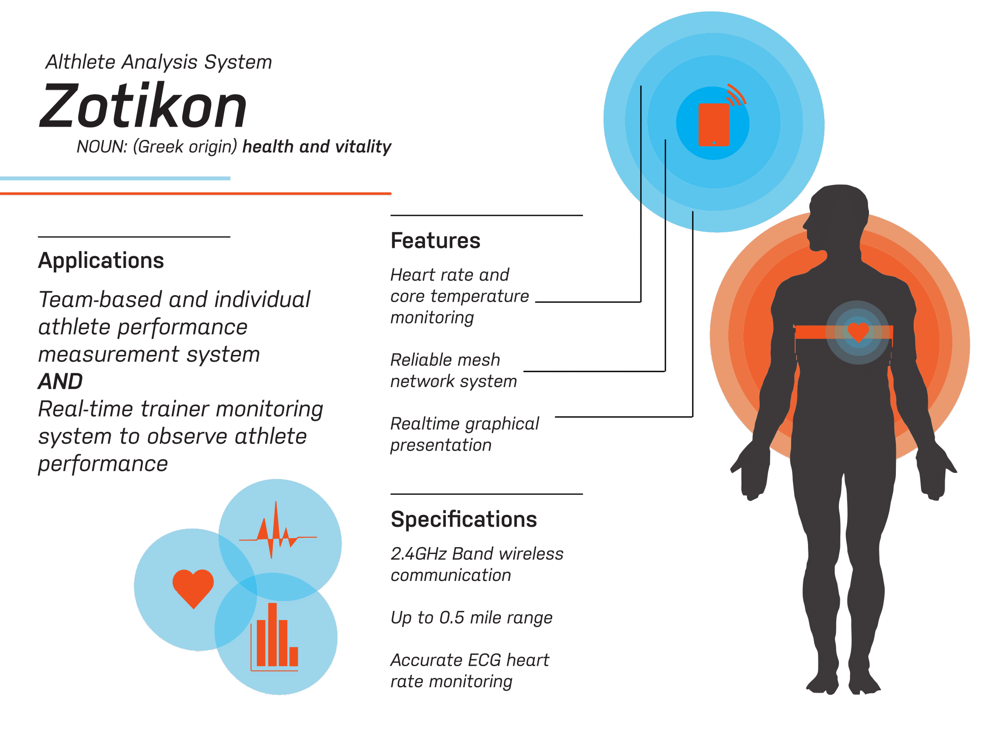

Slide 6
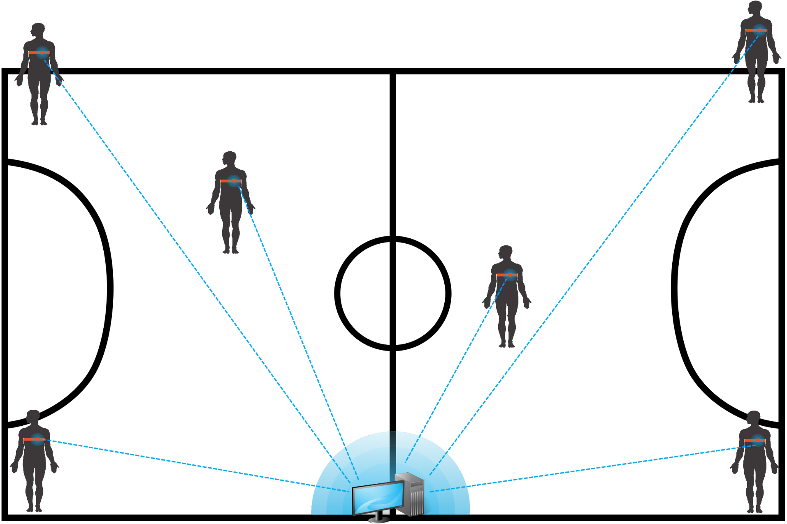
Problem Statement

Slide 7
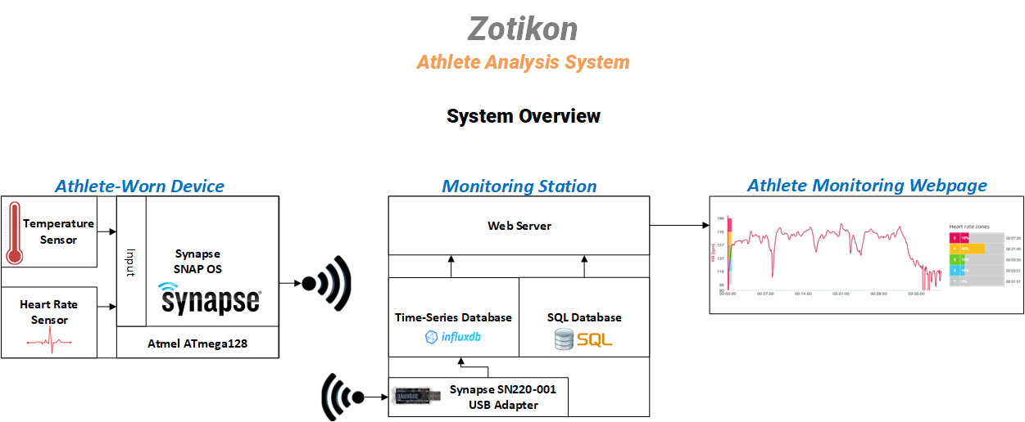
System Overview

Slide 8
Design Constraints Technical
Name | Description
Transmission Range | The Zotikon system must be able to reliably transmit data to at least 70 meters in a noisy environment with radio interference with a success rate of at least 90 percent.
Max Beats per Minute (BPM) | The maximum beats per minute the athlete-worn device must be able to measure is 220 BPM.
Simultaneous Users | The monitoring station must be able to receive data from 11 athlete-worn devices simultaneously.
Runtime | The athlete-worn device must be able to operate continuously for no less than 4 hours.
Body Temperature Measurable Range | The athlete-worn device must be able to measure temperatures in the range of 15℃ - 47℃ with 0.25℃ accuracy.

Slide 9
Design Constraints Practical
Type | Name | Description
Economic | Cost | Total System Cost: $3,000 Athlete-Worn Device: $150 Monitoring Station: $1,500
Environmental | Physical | IP64 Compliant Temperature Range: -40℃ to 85℃

Slide 10
Evaluation: Unit Test Heart Rate System
Input
Three Electrodes
Amplification
Instrumentation Amplifier
Filtering
First-order band-pass filter (0.5Hz < f < 150Hz)
Sampling
Analog-to-Digital Converter at 60Hz

Slide 11
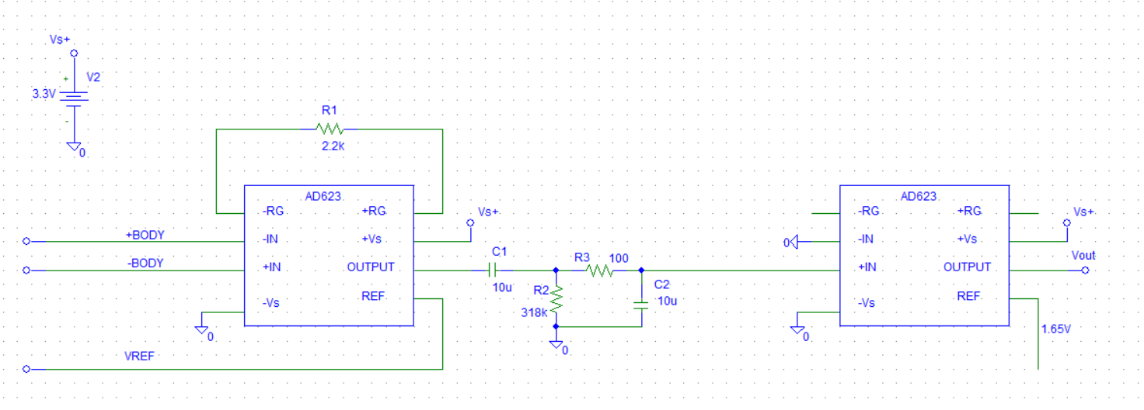
Evaluation: Unit Test Heart Rate System

Slide 12
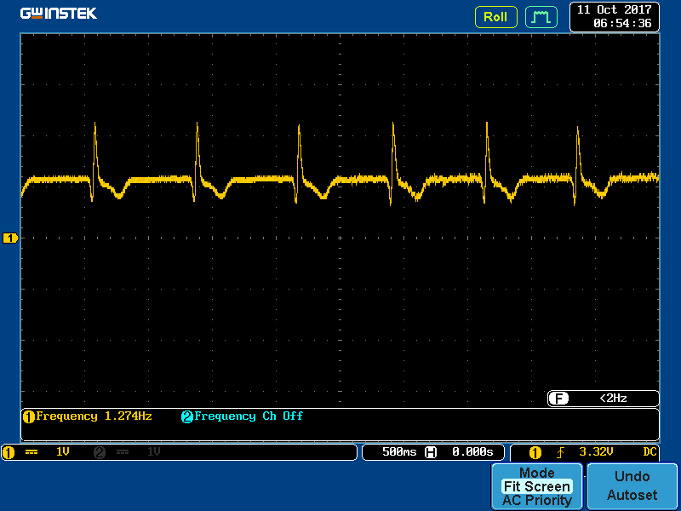
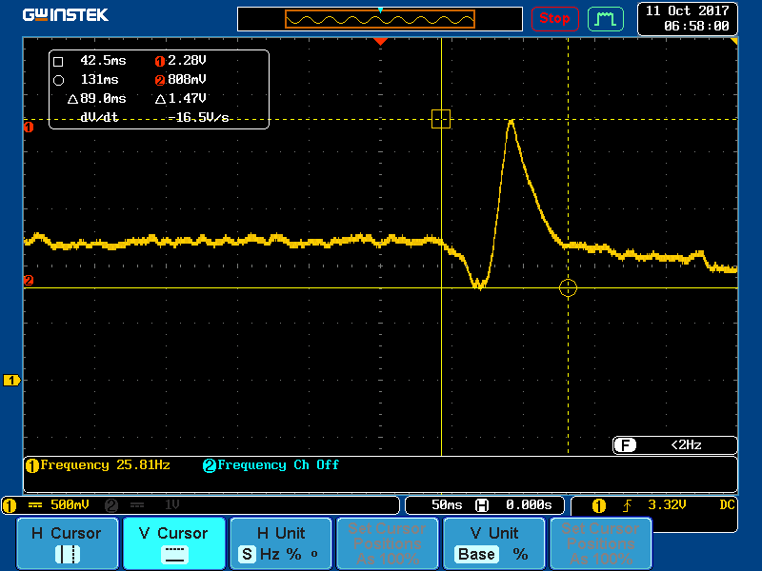
Evaluation: Unit Test Heart Rate System

Slide 13
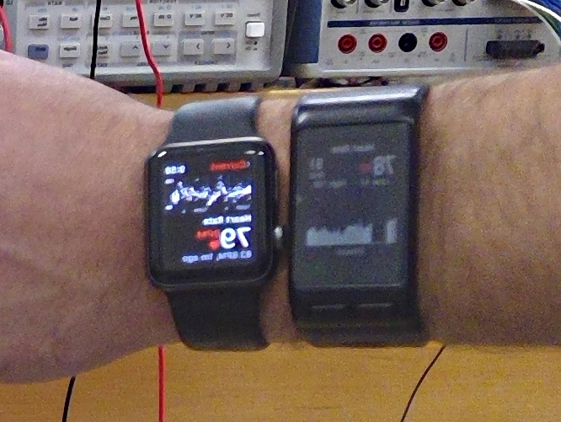
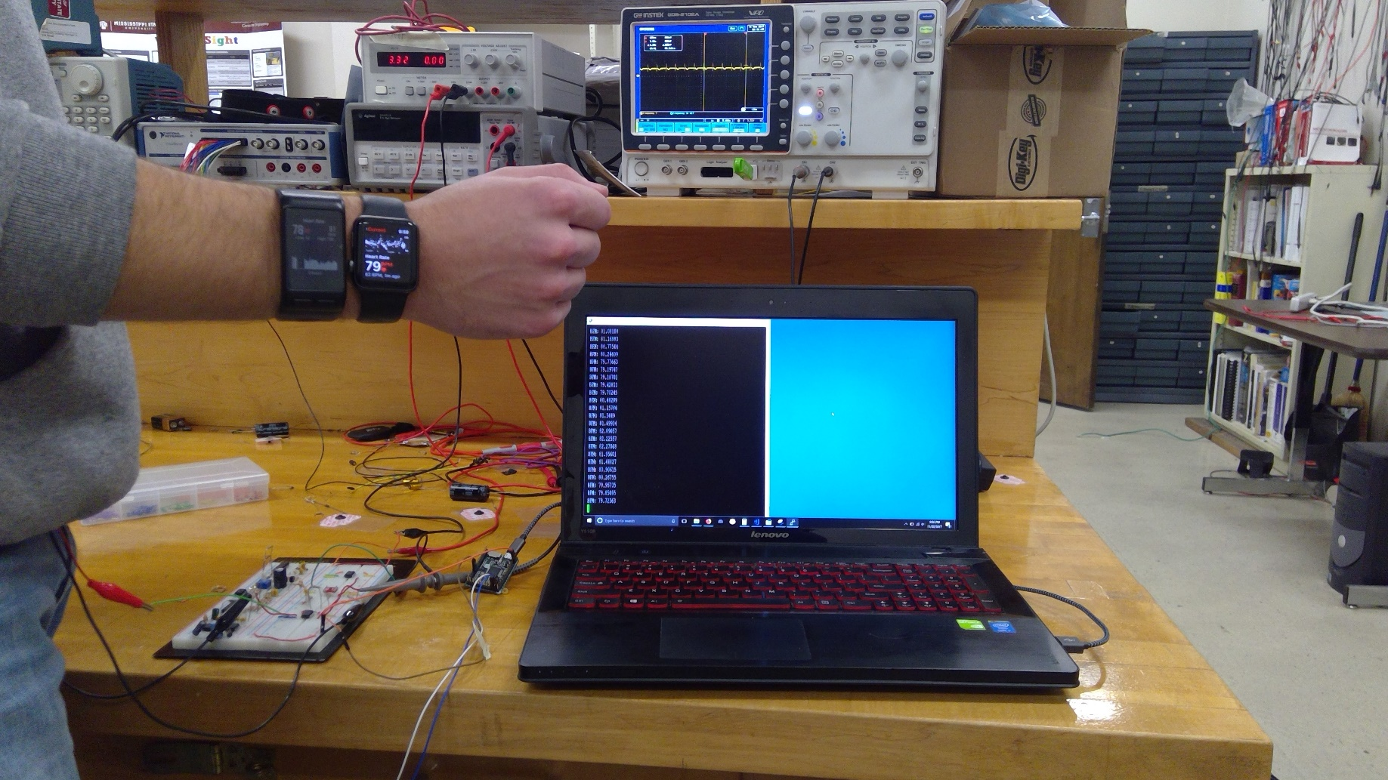
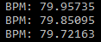
Evaluation: Unit Test Heart Rate System

Slide 14
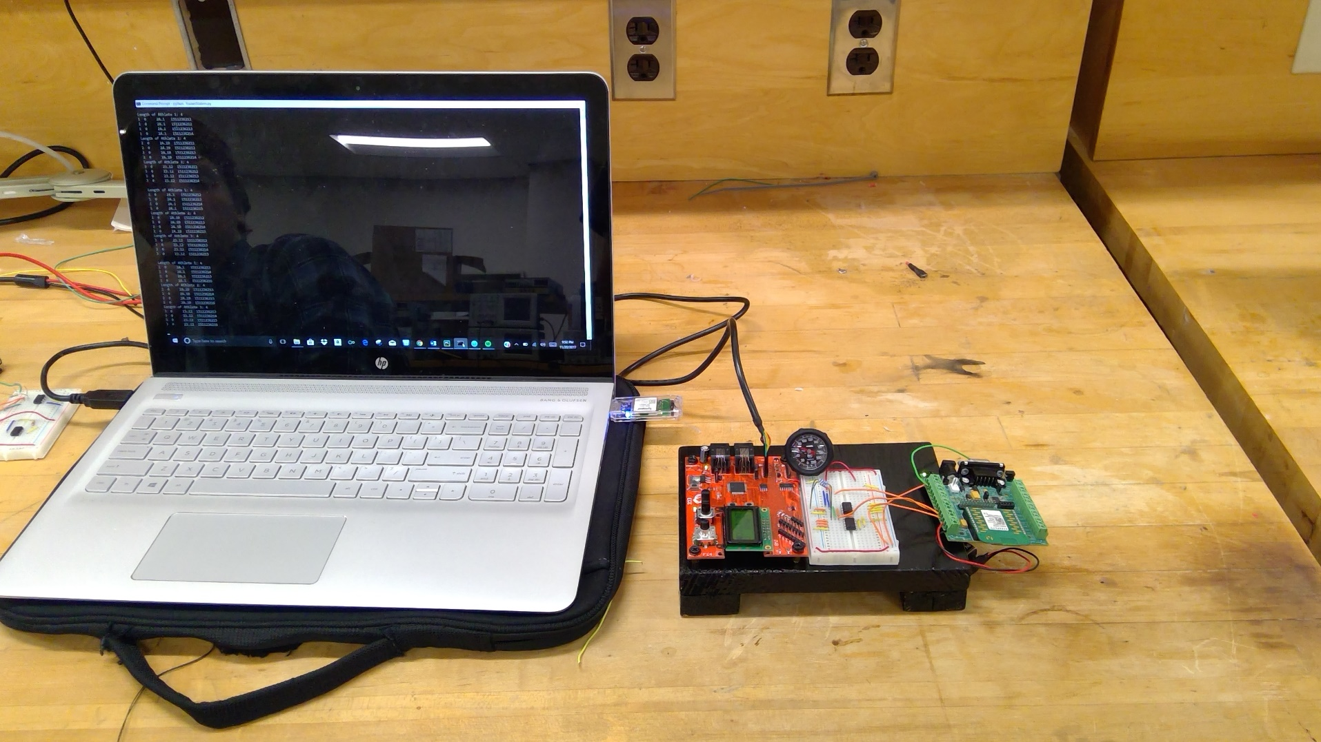
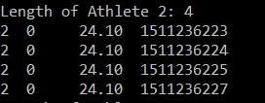
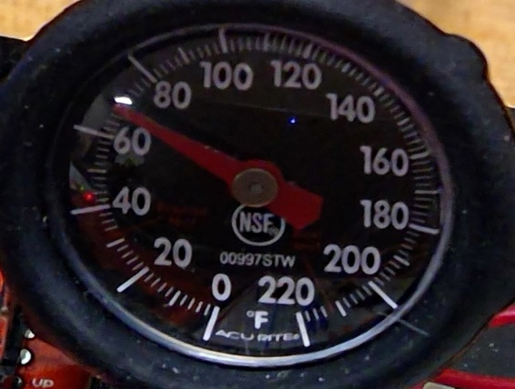
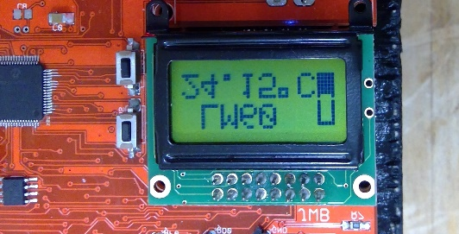
Evaluation: Unit Test Temperature System

Slide 15
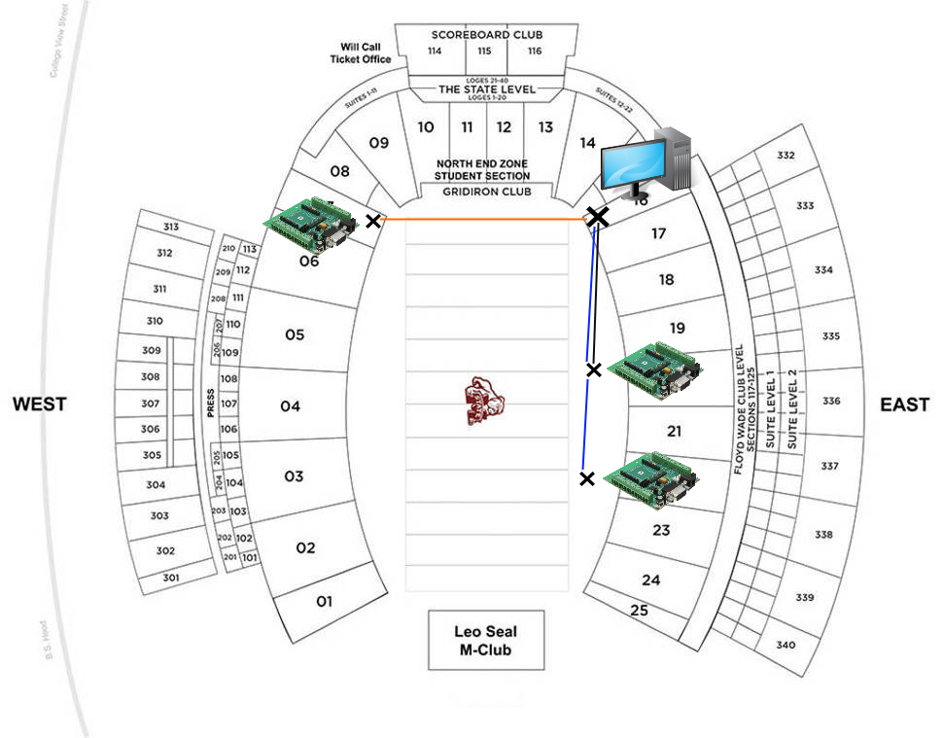
Evaluation: Unit Test Wireless System
Test Case | Monitor Station Location | Device 1 Location | Device 2 Location | Max Distance | Best Success Rate
1 | Sect. 16 | Sect. 19 | Sect. 19 | 50 yds | 79.31%
2 | Sect. 16 | Sect. 20 | Sect. 19 | 60 yds | 33.76%
3 | Sect.16 | Sect. 7 | Sect. 16 | 75 yds | 41.42%

Slide 16
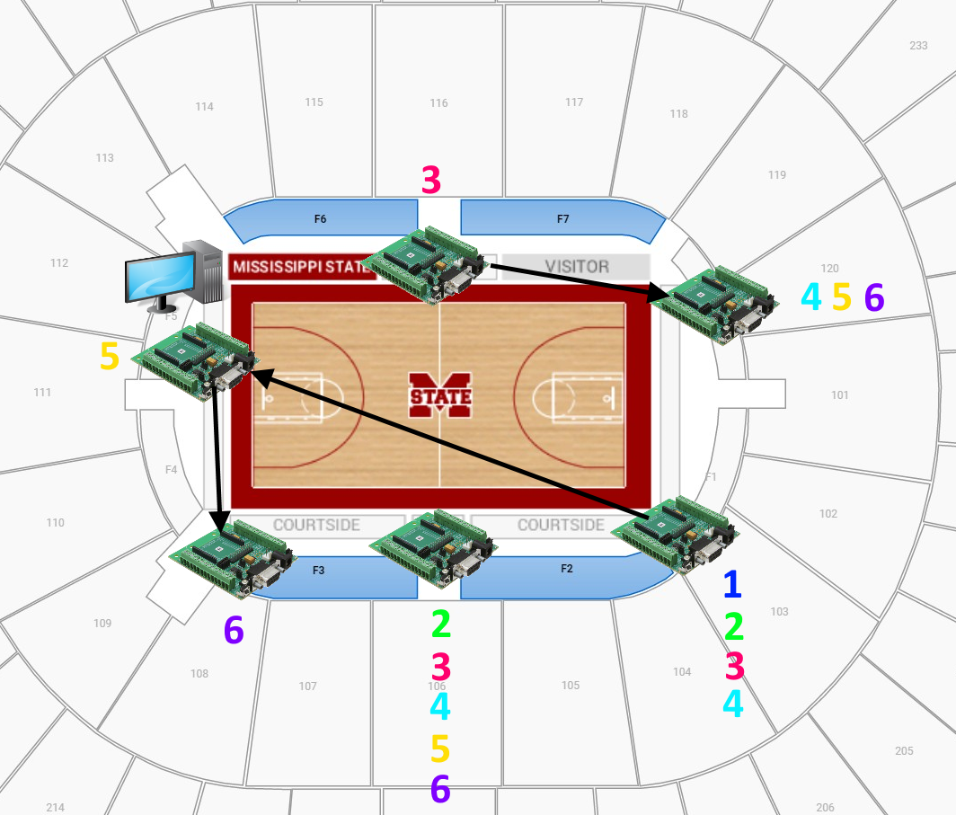
Evaluation: Unit Test Wireless System
Test Case | Device 1 Success Rate (%) | Device 2 Success Rate (%) | Device 3 Success Rate (%)
1 | N/A | N/A | 100
2 | 69.85 | N/A | 100
3 | 68.97 | 85.36 | 100
4 | 77.22 | 67.36 | 100
5 | 93.22 | 79.31 | 100
6 | 58.62 | 23.64 | 100

Slide 17
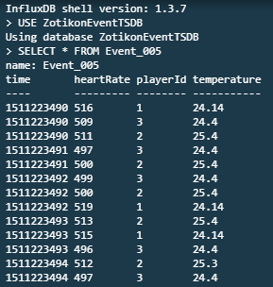
Evaluation: Unit Test Monitoring Station – Time-Series Database

Slide 18
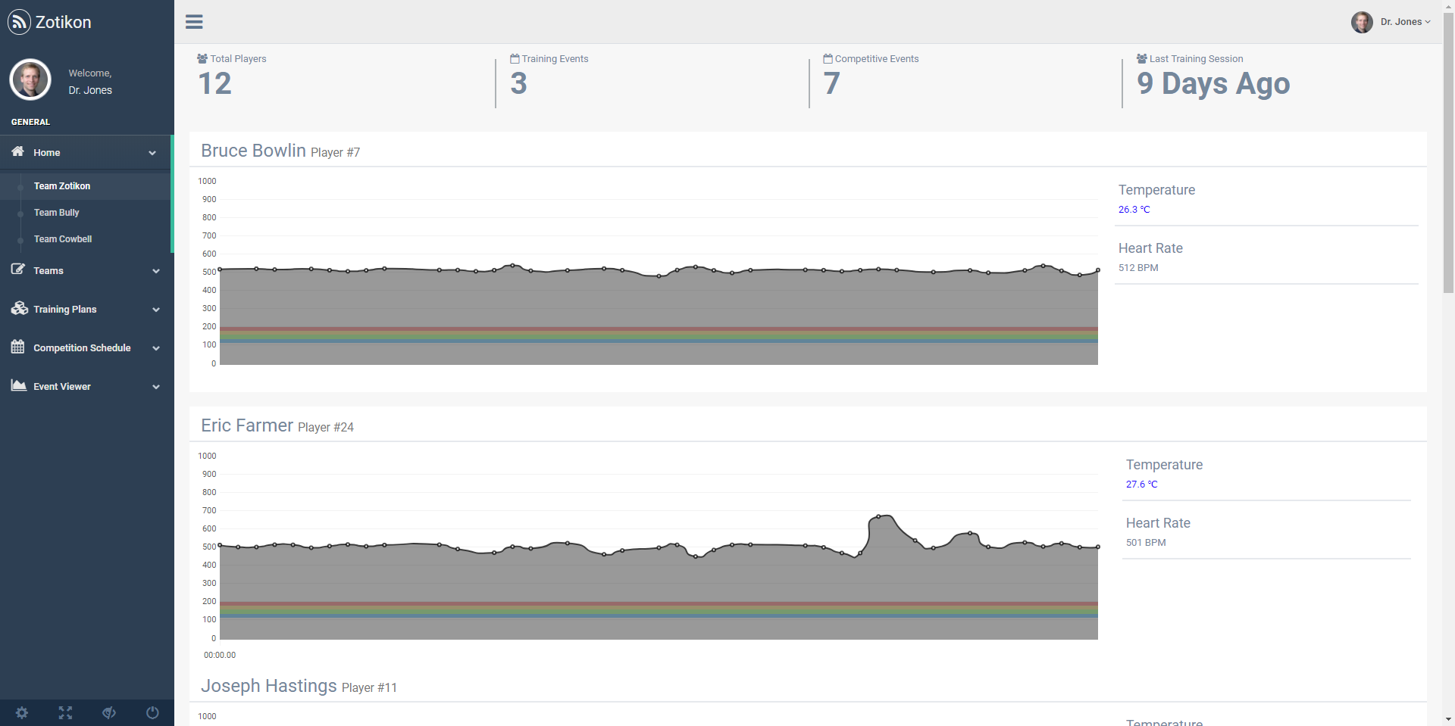
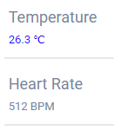
Evaluation: System Test Zotikon
`

Slide 19
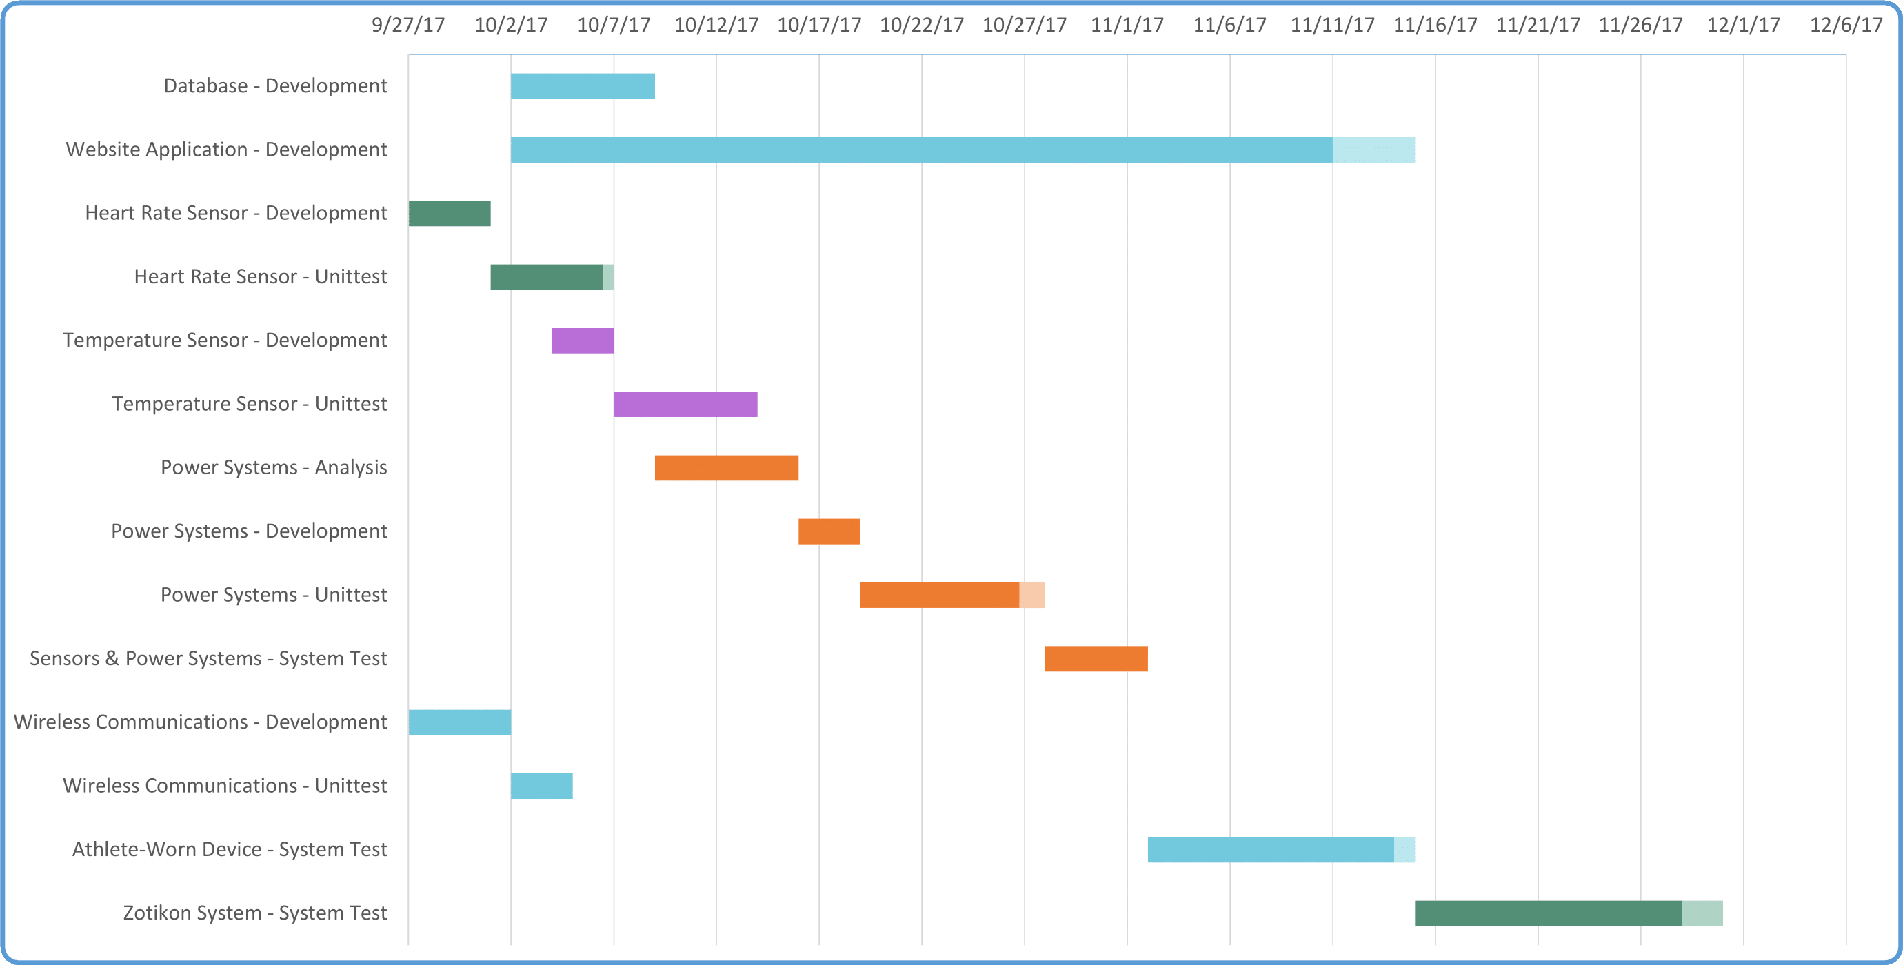
Project Timeline

